Slide 1
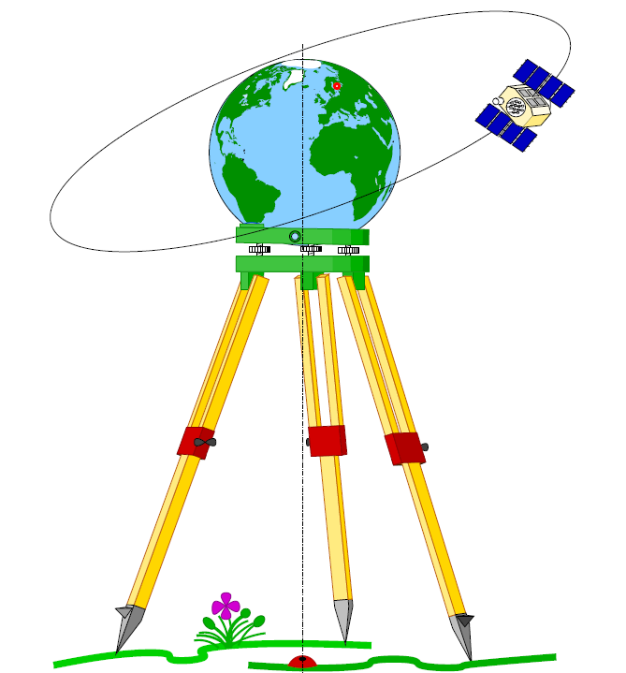
Geodesy-Review

Slide 2
Definition
Geodesy according to the classical definition of Helmert (1880):
''geodesy is the science of the measurement and mapping of the earth's surface“
Geodesy is the branch of science using mathematics, physics and gravity for
determining:
1- Location of points on the earth’s surface.
2- The size and shape of the earth via point positioining.
Geodesy may be divided into global geodesy, geodetic surveys, and plane surveying.
Global geodesy includes the determination of the shape and size of the earth,

Slide 3
A geodetic survey is for the determination of the earth's
surface and gravity field over a region that typically
spans a country or a group of countries.
The earth's curvature and gravity field must be
considered in geodetic surveys.
In plane surveying (topographic surveying, cadastral
surveying, engineering surveying), the details of the
earth's surface are determined on a local level, and
thus curvature and gravity effects are generally
ignored.

Slide 4
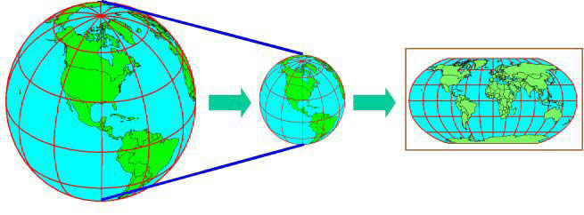
Mapping of the world onto plane coordinates

Slide 5
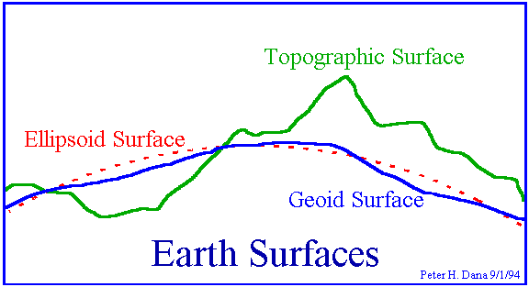
Figure of the earth
Physical surface of the earth, geoid, and ellipsoid

Slide 6
The physical surface of the earth is the border between the solid or fluid
masses and the atmosphere.
The irregular surface of the solid earth (continental and ocean floor
topography) cannot be represented by a simple mathematical
(analytical) function. It is therefore described point wise by the
coordinates of control points.
On the other hand, the ocean surfaces (70% of the earth's surface)
are easier to represent.
this surface as being extended under the continents and identify it as
the mathematical figure of the earth, which can be described by
a condition of equilibrium designated this level surface as geoid.
Geoid (or any other reference defined in the earth's gravity field) is well suited as a reference surface for heights.

Slide 7
Geoid
The geoid is an invisible, continuous closed surface
and is an equapotential surface or a level surface.
It is a surface at which the potential of gravity is
Constant.
A level surface is chosen that, on average,
Coincides with the surface of the oceans (m.s.l.).

Slide 8
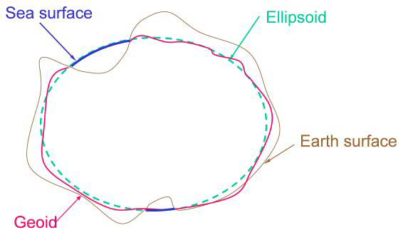

Slide 9
Ellipsoid
The ellipsoid is a three-dimensional model formed by rotating an ellipse about
its minor axis.
An ellipsoid is used as the reference system of the geoid instead of a sphere
because the earth is slightly flattened and it serves as a mathematical
model for locating the earth's features geographically..
Best-fit ellipsoid to geoid should achieve these conditions:
Its geometric center must be coincide with earth’s C.G.
Its size ~ equal to earth’s size
Σ N² = min.
Have the same axis of rotation

Slide 10
Ellipsoid or Spheroid Rotate an ellipse around an axis
An ellipsoid is uniformly defined through two parameters:
1. semi-major axis (a)
2. semi-minor axis (b)
Z
b
a
a
O
Y
X
Rotational axis

Slide 11
Relation between geoid & ellipsoid in term of height
H = h + N
Eq. surface
H h
Geoid
N
Ellipsoid
plumb/vertical line
physical surface of earth

Slide 12
Parameters of ellipsoid
1- flatenning f= a – b /a
2- first eccentricity e² = a² –b² / a²

Slide 13
3- second eccentricity e’² = a² –b² / b²
4- angular eccentricity f = 1 – cos α , e = sin α ,
e’ = tan α
Note: a, b, e and f define the size and shape of
the reference ellipsoid

Slide 15
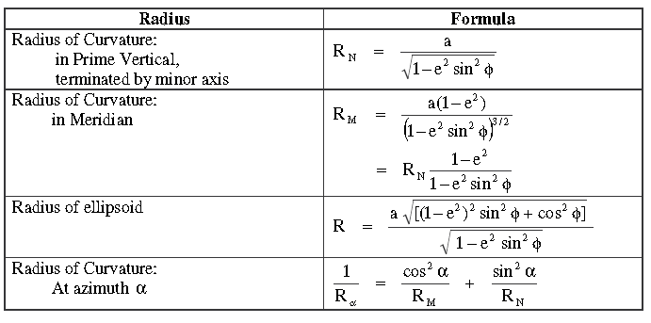
Radii of curvature

Slide 16
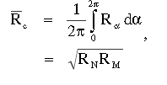
Average radius of the earth

